Slide 1
AGARPATHI
Designer vs Automated

Slide 2
Agarpathi - at a glance
8 boards: the 8 weakest boards from the UI run, re-run after the routing fix (designer picture vs app output)
2/8
2/8
4/8
0/8
Very close
Close
Different
Wrong proportions
pixel similarity 95 % or more
88-95 % similar
under 88 % similar - layout or text differs
aspect ratio differs from the designer's by more than 5 %
How it is measured
Each automated JPG is paired with the designer JPEG of the same S.No, size and shop (the designer's '(1)' side matches the automated file without a suffix). Similarity = 1 - mean grey-level difference of both pictures at the same reduced size (average 0.87). It rates the whole picture, so a different shop name or a small shift barely moves it - look at the slides.
Proportions are compared from the pixel size of each picture.

Slide 3
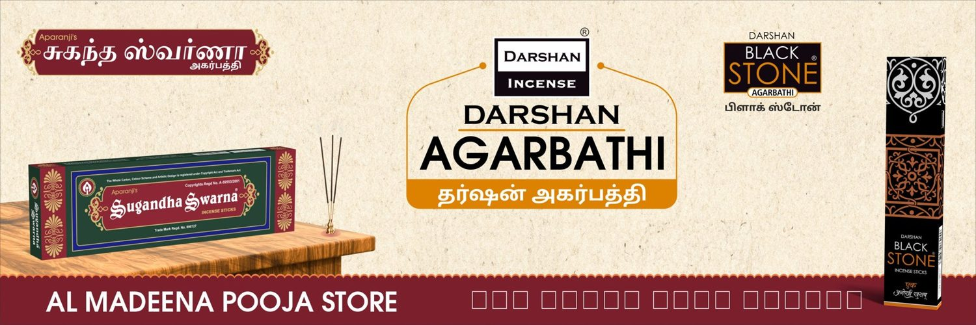

S.No 16
AL MADEENA POOJA STORE
12 X 4 Feet - Nonlit
VERY CLOSE (98 %)
DESIGNER
AUTOMATED

Slide 4
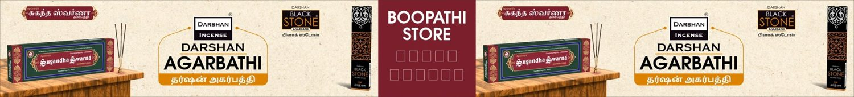
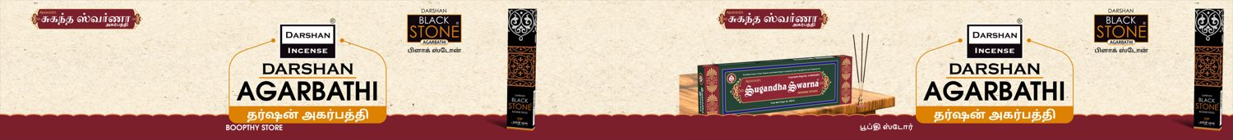
S.No 31
BOOPTHY STORE
35 X 4 Feet - Nonlit
DIFFERENT (83 %)
DESIGNER
AUTOMATED

Slide 5
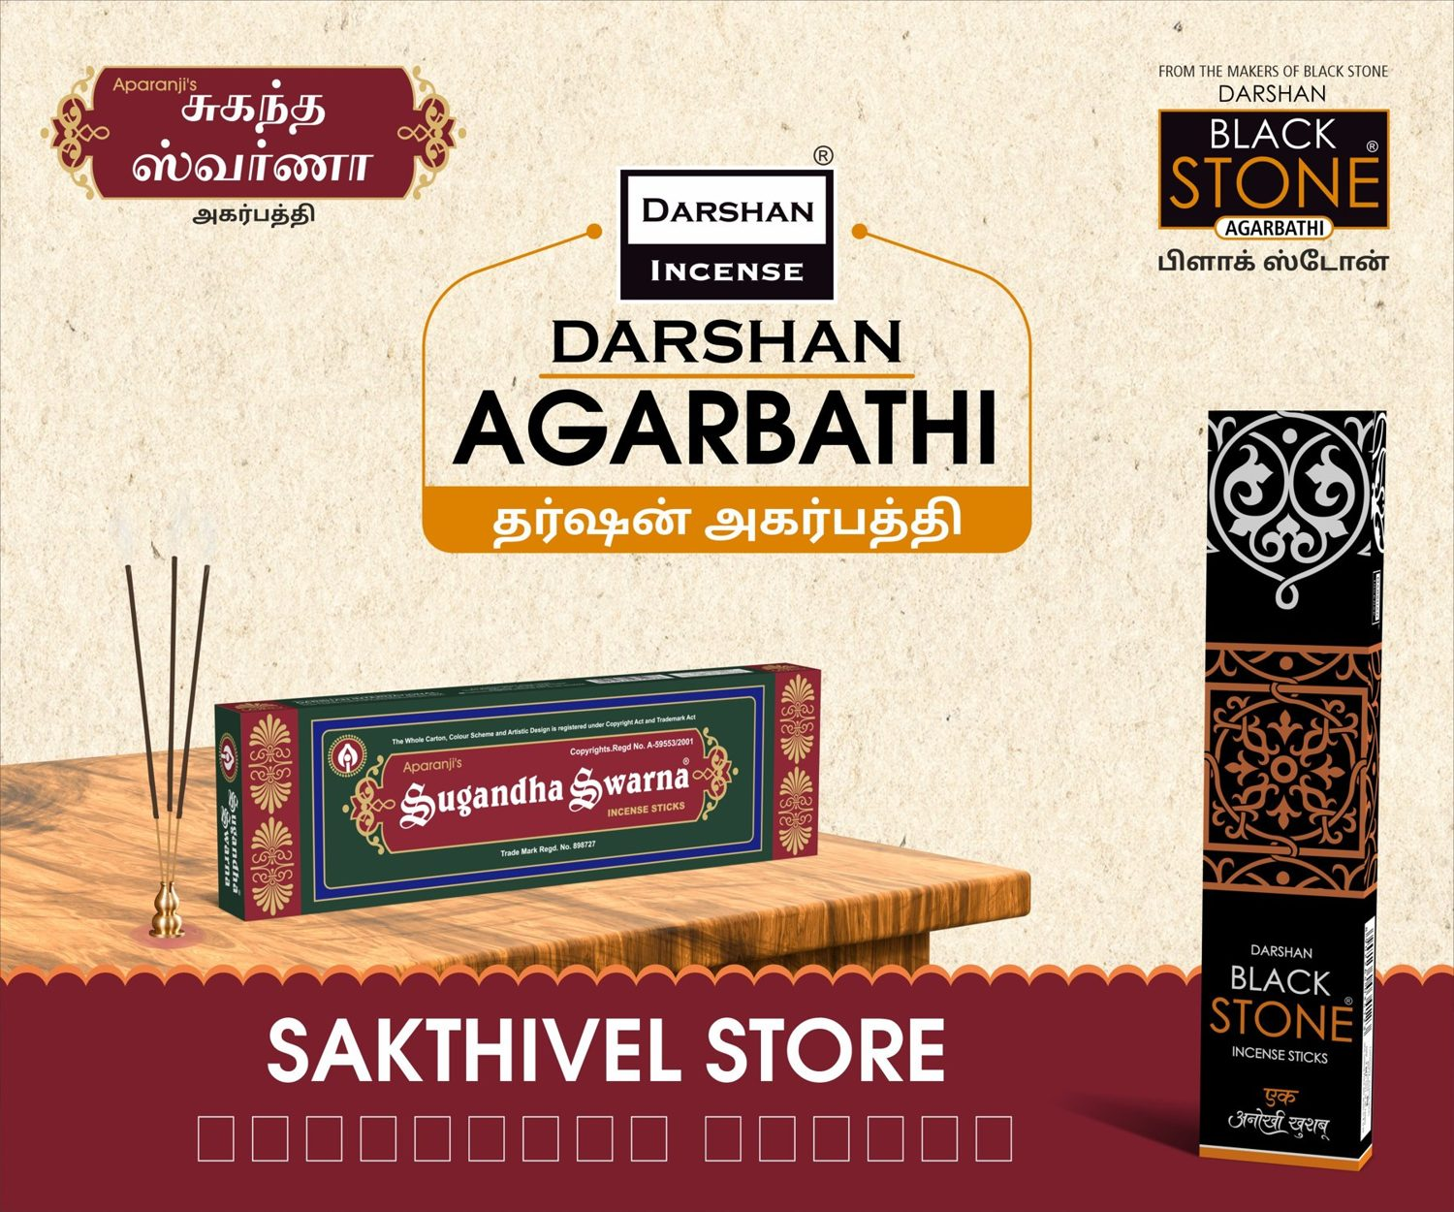
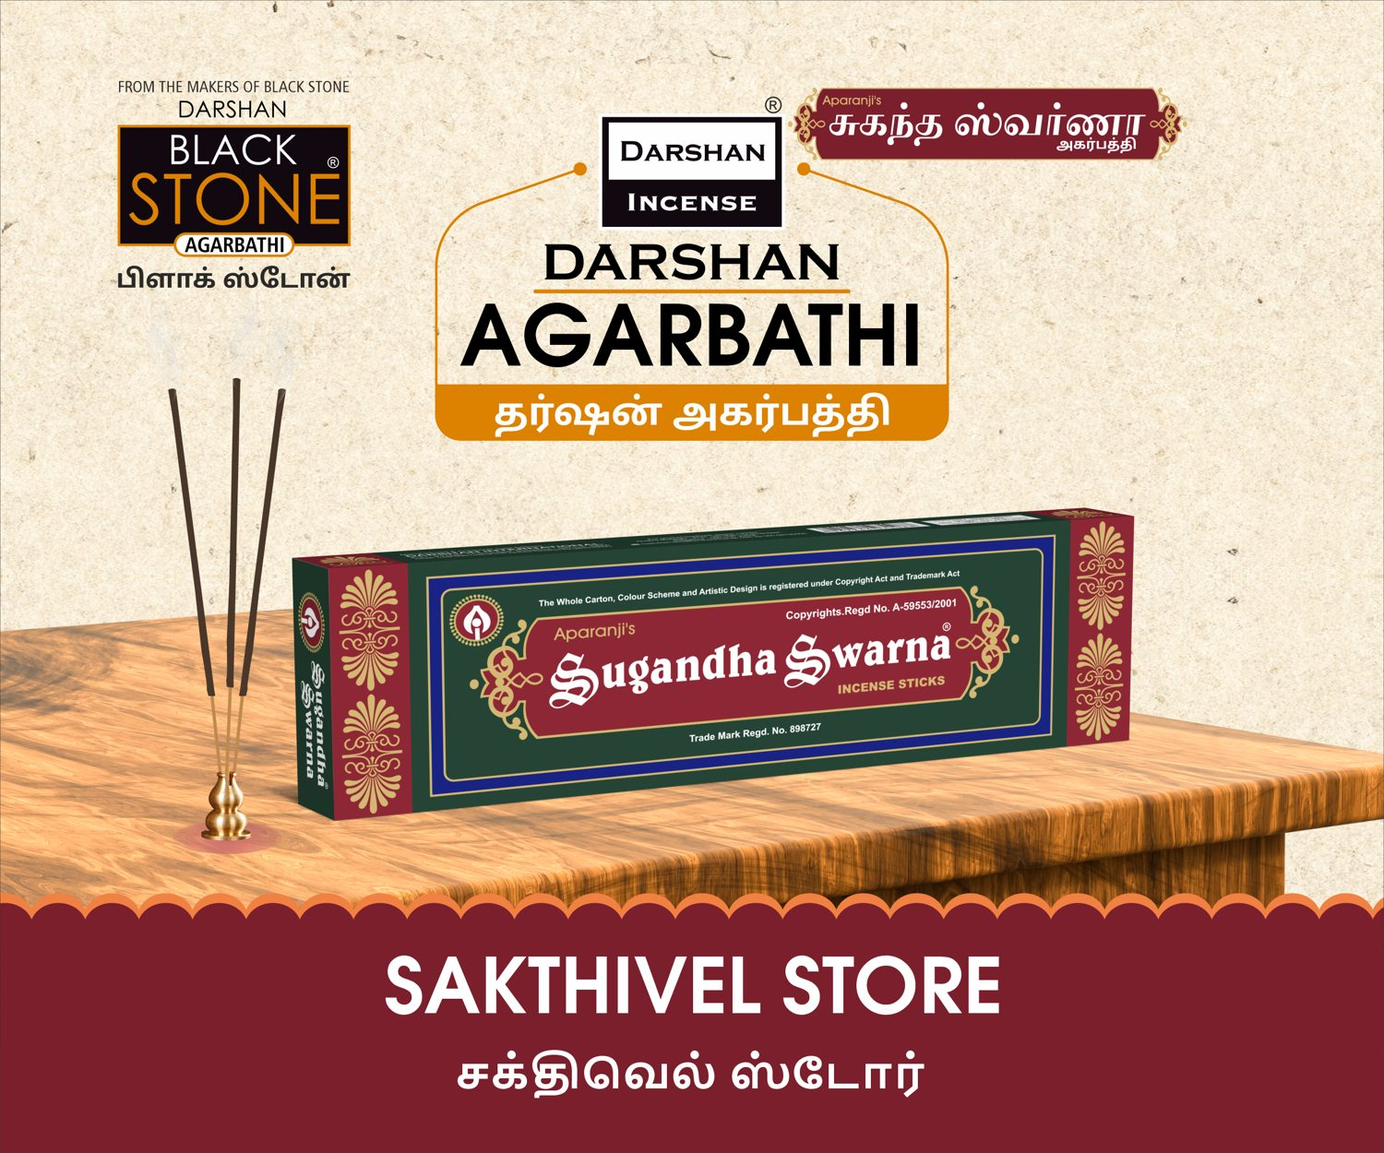
S.No 35
SAKTHIVEL STORE
6 X 5 Feet - Nonlit
DIFFERENT (77 %)
DESIGNER
AUTOMATED

Slide 6
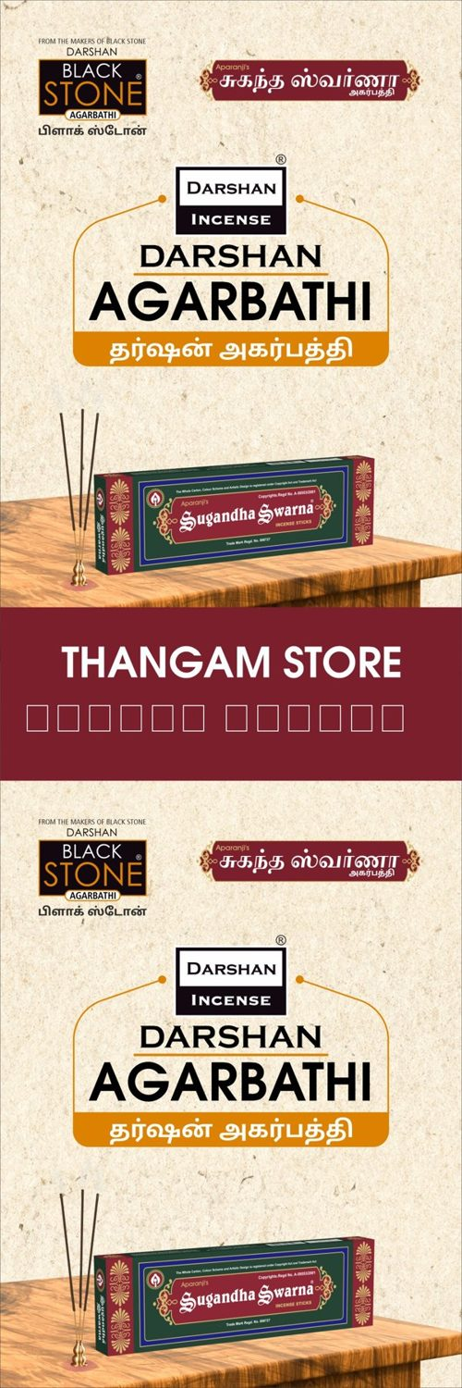

S.No 37
THANGAM STORE
2 X 6 Feet - Nonlit
DIFFERENT (73 %)
DESIGNER
AUTOMATED

Slide 7
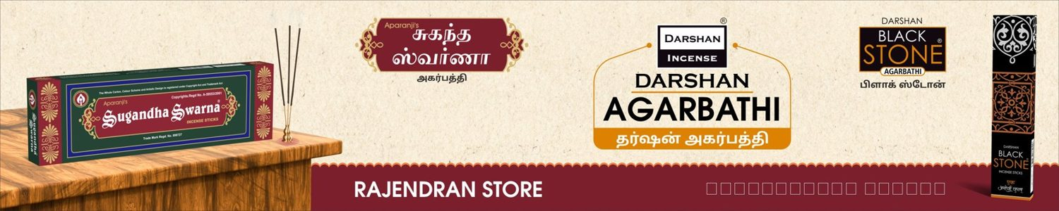

S.No 53
RAJENDERAN STORE
10 X 2 Feet - Nonlit
CLOSE (93 %)
DESIGNER
AUTOMATED

Slide 8
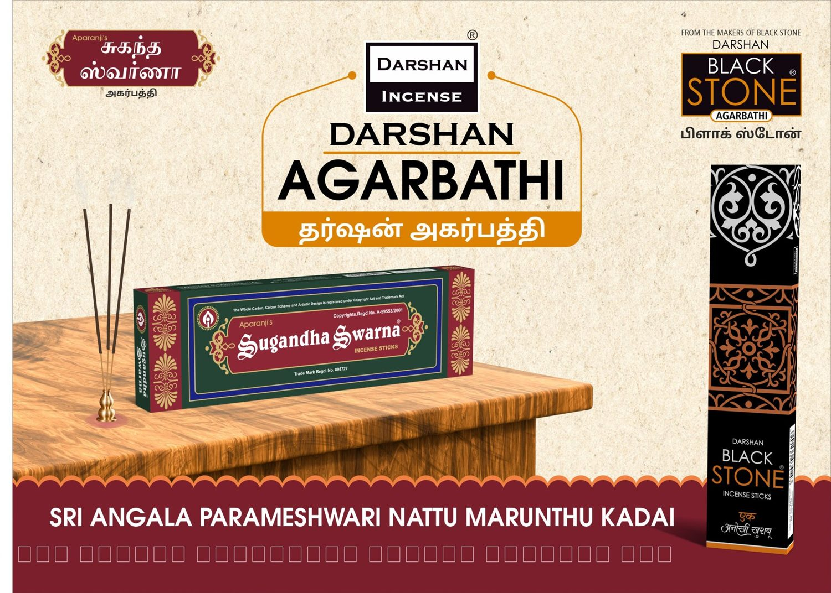
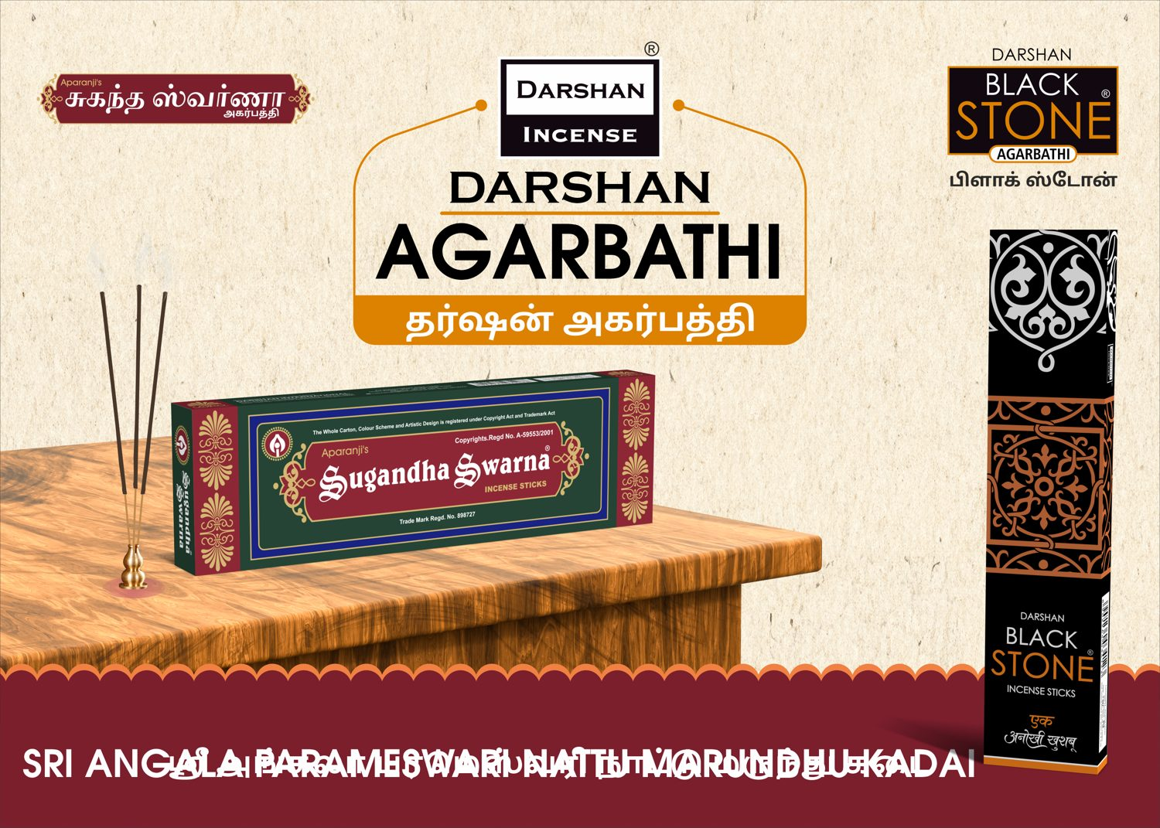
S.No 64
SRI ANGALA PARAMESWARI NATTU MARUNDHU KADAI
7 X 5 Feet - Nonlit
CLOSE (91 %)
DESIGNER
AUTOMATED

Slide 9
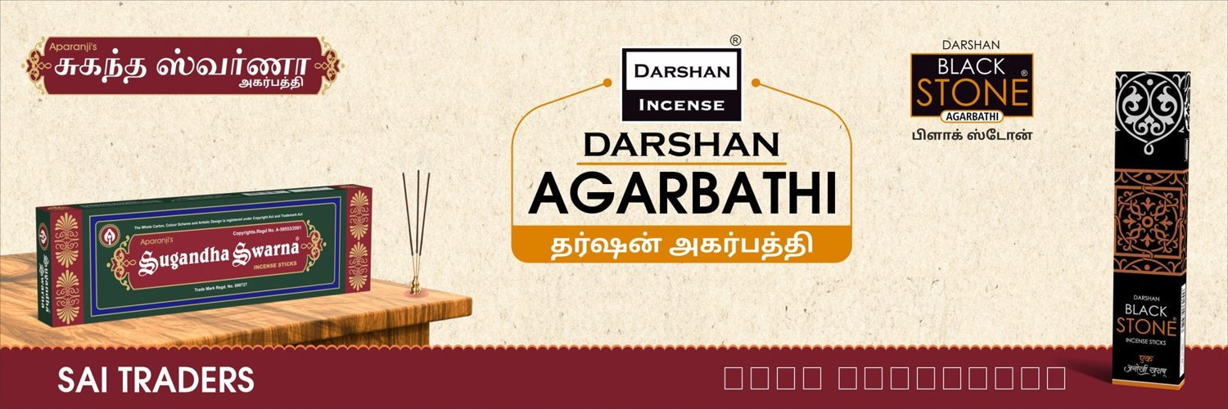

S.No 72
SAI TREDSES STORES
12 X 4 Feet - Nonlit
VERY CLOSE (98 %)
DESIGNER
AUTOMATED

Slide 10


S.No 75
SRI RAM NADUMARUTHU KADI
6 X 4 Feet - Nonlit
DIFFERENT (84 %)
DESIGNER
AUTOMATED

